Slide 1

Data in Azure
Jasmine Greenaway, Cloud Advocate
@paladique
aka.ms/university-azure/DataIntro​

Slide 2
Agenda
Introduction
Databases
Relational: Azure SQL Database, MySQL, PostgreSQL, MariaDB
NoSQL: Cosmos DB
Unstructured Data
Azure Storage Account and Data Lake
Azure Data Factory
Exercise: Jupyter Notebooks, MySQL and Azure Data Factory
Analytics and Additional Services
Azure Stream Analytics
Azure Databricks
Compute
aka.ms/university-azure/DataIntro​

Slide 3

Why Data in the Cloud?
Data can be a lot of work to maintain
Cloud can manage tasks that take longer on a server:
Backup, security, recovery, load balancing, encryption
Bring your dataset, use your tools:
Multiple ways to seamlessly migrate to Azure
Many options for storing your data, including virtual machines
aka.ms/university-azure/DataIntro​

Slide 4
Cloud Terminology
On Premise/On prem Describes physical servers that host data or services
Migration Moving data or services from one location to another
Migration from a on prem server to the cloud
Integration Ability to use other tools and services
"Cosmos DB integrates with the native MongoDB API"
Seamless Describes the ability to perform an action on data (backups) with no obvious changes to users and minimal downtime
"Seamless migration"
Fully managed Service in the cloud, using cloud features that you'd normally have to configure with on prem servers
Scalable Ability to meet varying demands of traffic or data and file processing
aka.ms/university-azure/DataIntro​

Slide 5


The Azure Data Platform
Databases
Data lakes & analytics
Azure SQL Database
for relational data
Azure Data Lake
for processing and analytics on data of any size, shape, and speed
Azure Data Services
Azure Cosmos DB
for non-relational/NoSQL data
Azure Databricks
for big data analytics and AI solutions
Data warehouses
Azure databases for MySQL, PostgreSQL, and MariaDB
open source relational data
Azure Synapse Analytics
for complex queries across petabytes of data
Azure HDInsight
for open source analytics
aka.ms/university-azure/DataIntro​

Slide 6

Databases
aka.ms/university-azure/DataIntro​

Slide 7


Relational Databases in Azure
My
Azure SQL
MySQL
PostgreSQL
MariaDB
Can be also be deployed to a virtual machine
Use your favorite tools and languages
Automatic scaling and backups
aka.ms/university-azure/DataIntro​

Slide 8

Cosmos DB
"Multi-model" DB – choose your API
Easy integration with Spark and Jupyter notebooks, just enable it
"Global distribution" - lets you put your data where it's being used the most
Result of this is low latency = data gets to end users faster
aka.ms/university-azure/DataIntro​

Slide 9

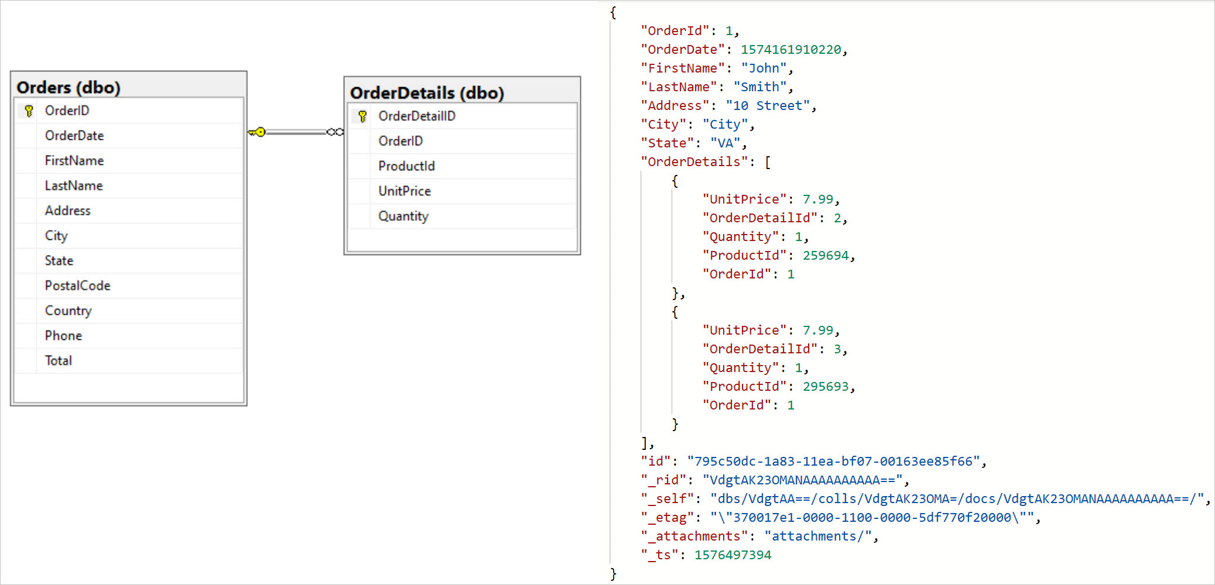
Example of NoSQL
aka.ms/university-azure/DataIntro​

Slide 10
Databases in Azure
Relational: Azure SQL, PostgreSQL, MySQL, MariaDB
Features like backups, security, etc are built in
Can be used in virtual machines
NoSQL: Cosmos DB
"Multi-model" DB – choose your API
Integration with Spark and Jupyter notebooks
Similar features as relational databases (backups, security, etc)
aka.ms/university-azure/DataIntro​

Slide 11

Unstructured Data
aka.ms/university-azure/DataIntro​

Slide 12



Azure Storage Account
Blobs
Files
Queues
Tables
Disks
Object storage
File storage, cross platform file share
Reliable messaging
NoSQL storage
For virtual machines
aka.ms/university-azure/DataIntro​

Slide 13
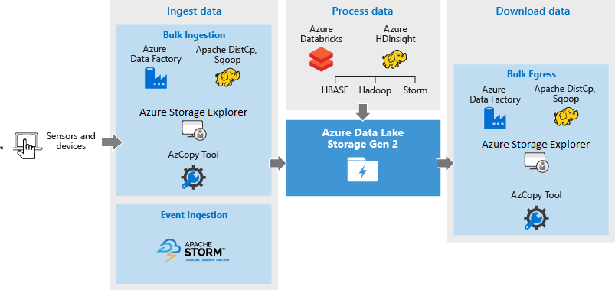
Data Lake
Part of the storage account, extension of Blob storage
Hierarchical File System: Easier to search
Open Source Integrations: HDInsight, Hadoop, Cloudera, Azure Databricks, Horntonworks
aka.ms/university-azure/DataIntro​

Slide 14
Unstructured Data in Azure
Storage Account
Multiple options under one service
Create a cross-platform file share with Files
Store different files with Blobs
Disks gives you multiple options for virtual machines
Queues are for sending small messages
Data Lake
Part of storage account
Ingest data from many sources, built into a hierarchical file system
Integration with open source platforms
aka.ms/university-azure/DataIntro​

Slide 15

Azure Data Factory
Transform & Analyze
MapReduce
BI & analytics
No SQL
Blob
Hive, Pig
VM
Store trusted data
Spark
DB
C#
Azure Machine learning
Stored Procedure
Ingest
Hybrid data integration at a global scale
Create, schedule, and monitor data pipelines
Fully managed ETL service in the cloud
Accelerate your data integration with multiple native connectors
aka.ms/university-azure/DataIntro​

Slide 16
Exercise: Azure Data Factory and Jupyter Notebooks in Azure Machine Learning Studio
aka.ms/university-azure/DataIntro​

Slide 17
Additional Azure Services for Data
aka.ms/university-azure/DataIntro​

Slide 18
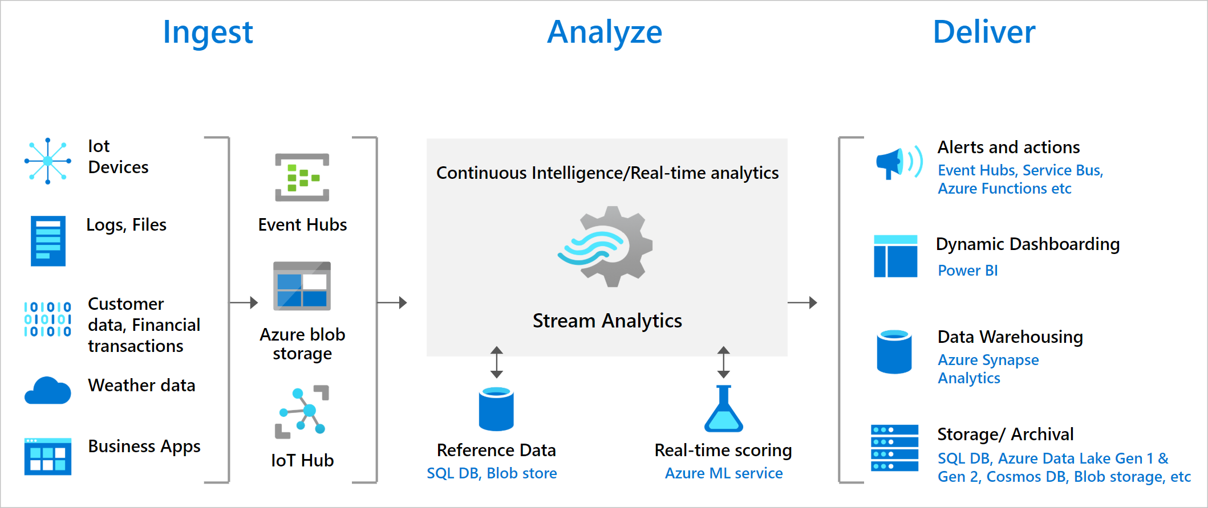
Azure Stream Analytics
aka.ms/university-azure/DataIntro​

Slide 19
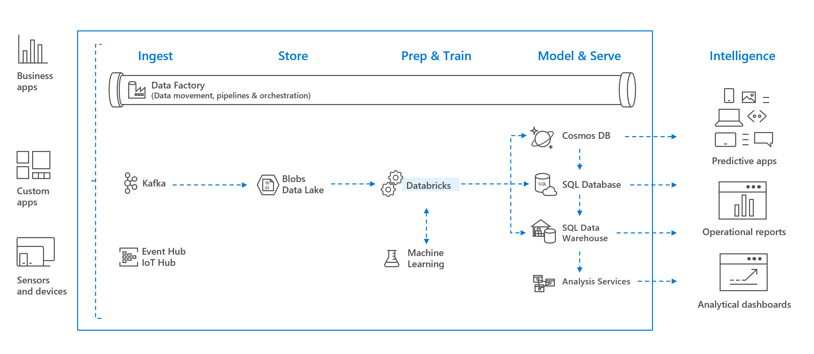
Azure Databricks
aka.ms/university-azure/DataIntro​

Slide 20
Compute
Compute in Azure Machine Learning Studio
Choose CPU or GPU
Automatically scales to meet compute demands
Virtual Machines (Linux (many distributions), Windows)
Vast set of different options from general purpose, high performance compute, GPU, and more
Tip: Azure Machine Learning studio is great for experimental compute
aka.ms/university-azure/DataIntro​

Slide 21

Where does your data fit in Azure?
aka.ms/university-azure/DataIntro​

Slide 22
Considerations for data in the cloud
What is the structure of your data?
How much data will you be working with?
Is having some of your data on a physical server (on premise) important to you? Do you need access to a virtual machine?
What tools or services depend on your data right now?
Will this data be accessed by many?
Will you need additional compute resources?
aka.ms/university-azure/DataIntro​

Slide 23
Migrate: Moving Data to Azure?
Databases: Most migration tooling inside Azure Migrate
All Databases: Azure Database Migration Service
SQL Server: Database Migration Assistant
CosmosDB: Cosmos DB Data Migration tool
Files: AzCopy (Command line)
Alternative: set up a file share with Azure Storage explorer, migrate to Blob storage with Azure Data Factory
aka.ms/university-azure/DataIntro​

Slide 24
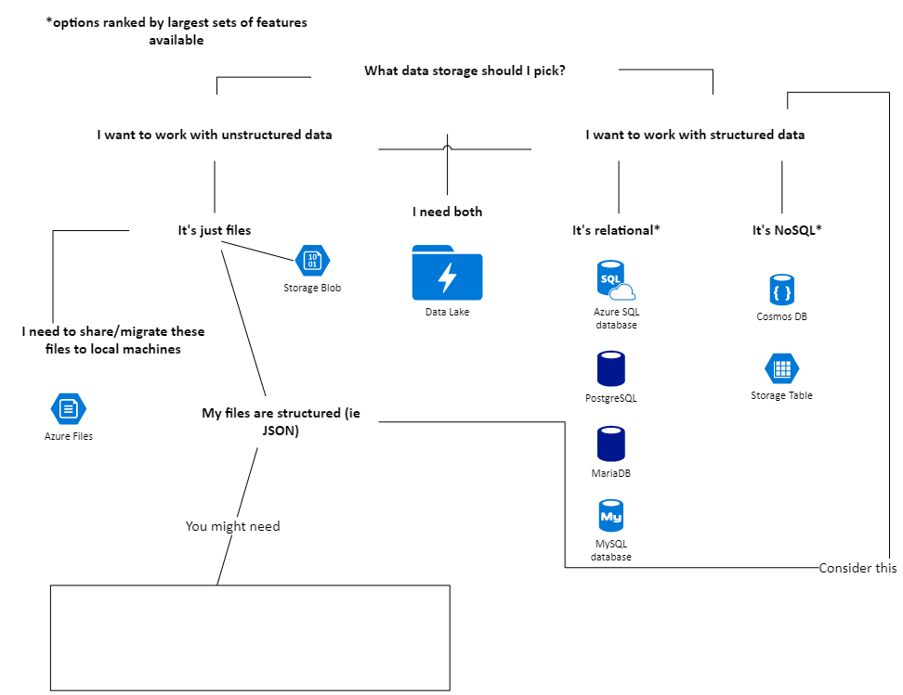
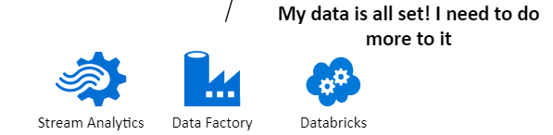
Your choice depends on your data
aka.ms/university-azure/DataIntro​

Slide 25
What's in the resources?
Samples of this presentation's demonstration
Short summary of this presentation
Info on where to go from here
Links to:
Microsoft Learn Modules
Documentation
aka.ms/university-azure/DataIntro​

Slide 26
Data in Azure
Jasmine Greenaway, Cloud Advocate
@paladique
aka.ms/university-azure/DataIntro​

